Slide 1
READY, SET, NEURO!
Notes:
Welcome to Work Those Muscles! A virtual Kin Lab Days presentation brought to you by the Department of Kinesiology at the University of Waterloo. In this presentation, you will put your muscles to the test and learn about muscle force generation through the various experiments that you will perform. Let’s get started!
https://uwaterloo.ca/kinesiology/sites/ca.kinesiology/files/uploads/files/kld_wtm_recording_sheet-202103.pdf

Slide 2
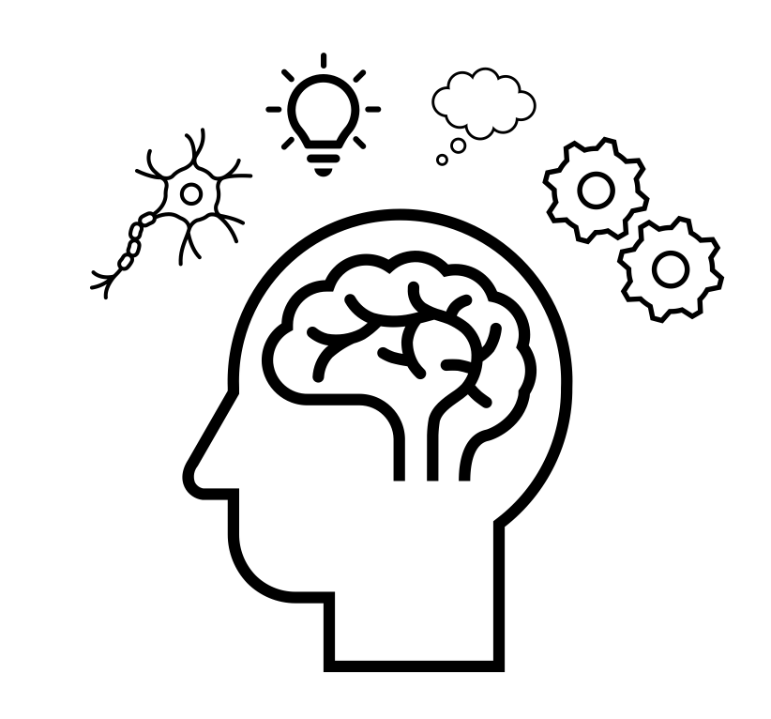
Purpose
Students will…
Examine the stages of motor learning
Investigate what makes a task automatic
Gain an understanding of the role of response time by investigating:
Reaction Time & Movement Time
Hick’s Law
Fitt’s Law
Notes:
During this presentation, you will gain an understanding of motor learning and response time under the lens of neuroscience.
You will get a chance to:
Examine the stages of motor learning
Investigate what makes a task automatic
Gain an understanding of the role of response time by investigating: Reaction Time and Movement Time, Hick’s Law, and Fitt’s Law.
We will explore each topic in more depth, perform experiments related to the topics, identify the expected results, and have some group discussions.

Slide 3
NEUROSCIENCE
Notes:
To provide you with some background knowledge for this workshop, we’re going to talk a little bit about neuroscience as a study.

Slide 4
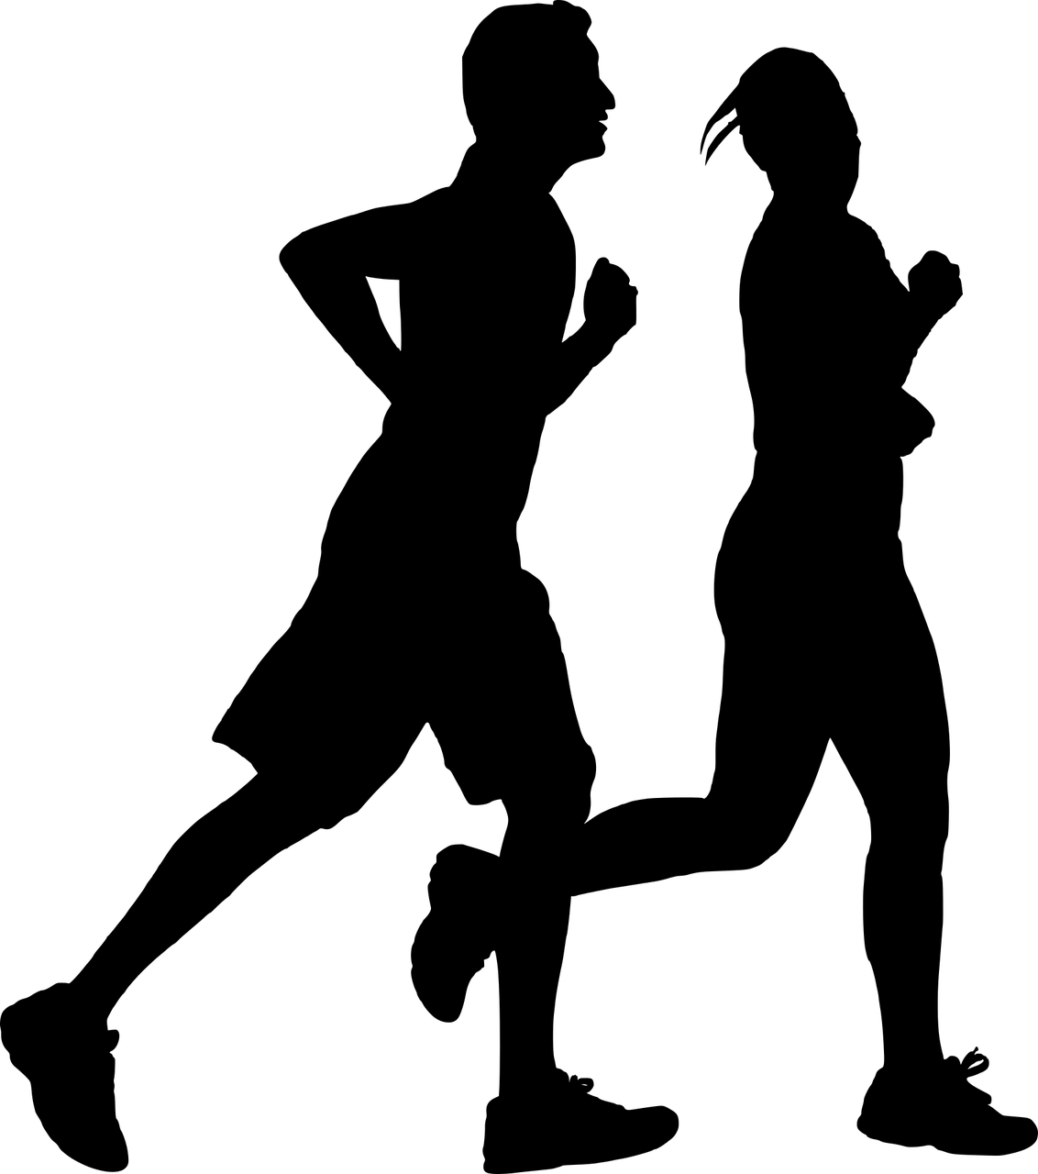
What is Neuroscience?
Science of the nervous system
Neural control of movement and behavior that connects cognitive and emotional functions to physical movement
Notes:
What is Neuroscience? Neuroscience is the scientific study of the nervous system. In Kinesiology, we are specifically interested in studying the neural networks that control movement and human behaviour. Some examples of movement or behaviours could include cycling, jogging, and throwing or catching a frisbee. We’re also interested in studying movement disorders and neurological diseases such as Parkinson’s Disease.

Slide 5
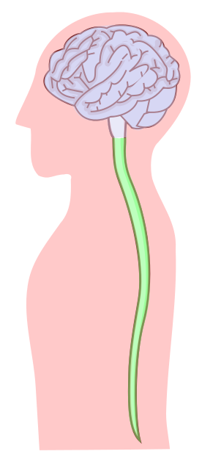
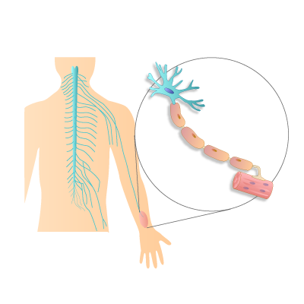
Neuroanatomy
The Nervous System
The Central Nervous System (CNS)
The Brain and Spinal Cord
Interpreting stimuli and determining a response
The Peripheral Nervous System (PNS)
Carries information to and from the CNS
Activates muscles via “motor neurons”
PNS
CNS
Notes:
In order to understand neuroscience, we need to know a little bit about neuroanatomy.
The human nervous system allows us to process information from our environment and respond to different signals through our various senses. The nervous system has 2 main components: the central nervous system (CNS) and the peripheral nervous system (PNS).
The CNS consists of the brain and the spinal cord and is responsible for interpreting stimuli from our environment and determining the appropriate response. For example, if you were driving and came across a red light, your CNS would interpret the red-light stimulus and decide that you need to apply the brakes. The brain has multiple lobes. This allows the brain to process, organize, and store different types of information. For example, the occipital lobe is primarily responsible for processing visual information, while the temporal lobe is primarily responsible for processing auditory information.
The PNS functions to carry information to and from the CNS. The body has many networks of nerves that merge with the CNS and extend throughout the body. This allows for the transmission of information. We have sensory receptors all over our bodies that detect different stimuli, and you can see that our nerves extend to every edge on the body to allow for communication between receptors and nerves. When receptors detect stimuli, they transmit that information to what are known as afferent neurons. Afferent neurons then transmit the information to the CNS where it gets interpreted, and the response signal travels to the appropriate muscles or tissues via efferent neurons.

Slide 6
RESPONSE TIME
Notes:
Now, we’re going to talk about response time and what is occurring in the nervous system when we respond to a stimulus.

Slide 7
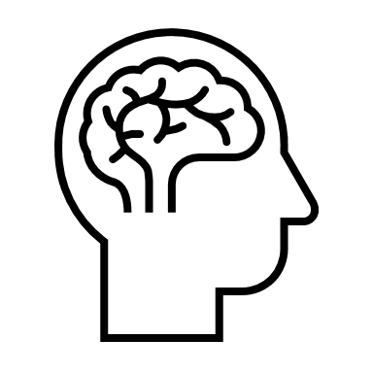
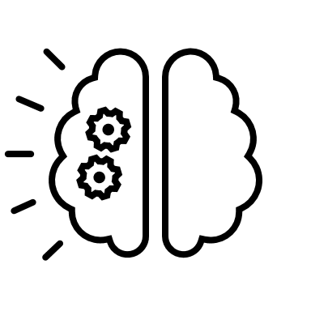
Response to Stimuli
Example: Swinging a baseball bat
Reaction Time (RT)
Movement Time (MT)
Stimulus
Muscle Activation
Movement completion
Response Time
Notes:
One way we measure the speed of the brain is by connecting a stimulus to a corresponding movement. This time measurement is known as Response Time. As you can see in this diagram, response time includes both reaction time and movement time.
***Reaction time (RT) is the time it takes to initiate a movement, or more specifically, the time between the onset of a stimulus (ex. a pitcher throwing a baseball) and onset of muscle activation. In this baseball example, the stimulus, which could be seeing the baseball being thrown, travels to the athlete’s eye and is detected by photoreceptors on the retina (the back of the eyeball). The photoreceptors then send a message to the brain, and the brain interprets the signal and determines the appropriate response. Then, the brain sends a signal to the muscles via the spinal cord, causing them to activate so they can perform the required movement.
The next phase is movement time (MT), which is the time between the onset of muscle activation and the completion of the required movement. Once the signal from the brain reaches the muscles, the muscle fibers begin to contract. This leads to the player starting the movement of swinging the bat. In this scenario, movement time would end when the player has finished swinging the bat.
To summarize, reaction time is that time between the baseball being thrown and onset of muscle activation, and then movement time is the time between the onset of muscle activation and the follow through after hitting the ball. And as mentioned earlier, response time is the time it takes for both reaction time and movement time to occur.
Since we rely on muscle activation to identify the end of reaction time and the beginning of movement time, we need electromyography (EMG) equipment in order accurately measure reaction time and movement time.

Slide 8
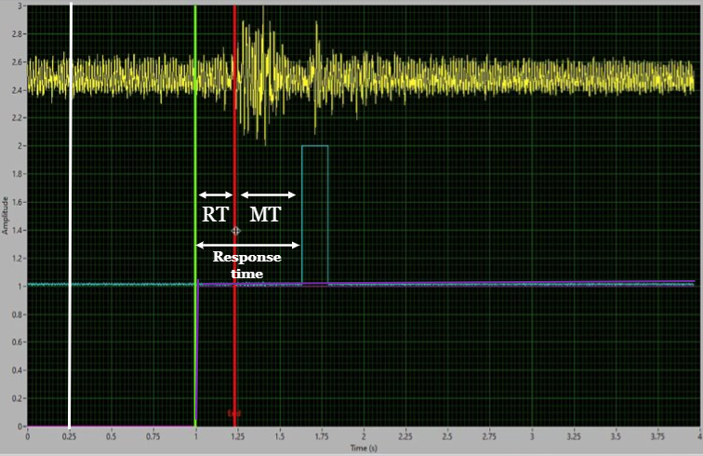
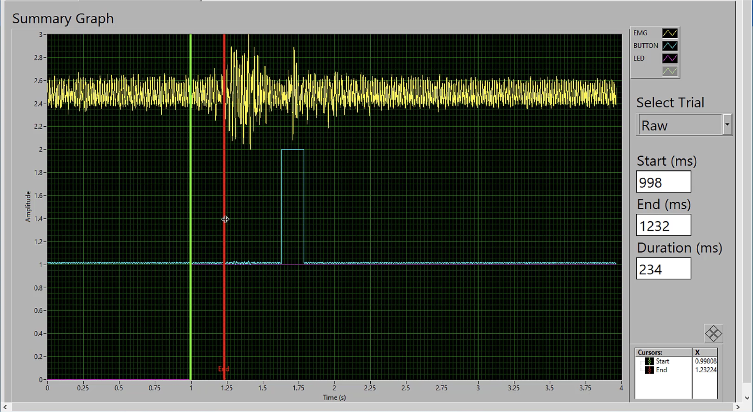
Electromyography
EMG
Stimulus
RT
MT
Response time
403
Onset of Muscle Activation
Notes:
To measure the electrical activity of the nervous system activating a muscle, we used what is called “electromyography” or EMG. This is what the EMG signals we collect in the lab look like (yellow line). In this experiment, the participant had to press a button as quickly as possible when a light flashed. The yellow line at the top represents the EMG for the muscle (it was the anterior deltoid in this experiment), the blue line represents the button being pressed and that signified by the vertical component, and the purple line represents the stimulus, which would be the light signal. And again, it’s the vertical component of the purple line that represents the moment where the light flashed. Along the X-axis is time in seconds and along the Y-axis, is signal amplitude measured in volts.
We’re able to collect data from muscles by attaching electrodes to the area of skin over the target muscle. At rest, the muscle is inactive and therefore the EMG signal (yellow line) would be relatively flat and stable. As you can see on the graph, shortly after the time the stimulus is introduced, the EMG signal starts spiking (or amplitude is increasing) at the red vertical line. This tells us that the muscle has been activated.
Since we don’t have any EMG equipment to use in these asynchronous sessions, our reaction time experiments are technically going to be measuring our overall response time. However, when we’re responding to different stimuli in the experiments, we will be performing the same movements, so our movement time won’t really change. Thus, any differences we see in response times will be a result of differing reaction times. This will make more sense when we start doing the experiments.

Slide 9
What Influences Reaction Time?
Stimulus modality: What sensory system is receiving the stimulus?
Speed of processing: How long does it take for information to travel within PNS and be interpreted by CNS?
Example: Visual vs. auditory processing
5 SENSES
Notes:
Reaction time can be influenced by the stimulus modality.
Stimulus modality refers to the form of the stimulus, and we have the ability to detect many different forms of stimuli. As seen on the right, some examples would include touch, sight, taste, sound and smell.
Speed of processing refers to how fast information can be detected (via transduction), moved and interpreted within the nervous system. The modality of the stimulus can affect the speed processing. This is because our sensory systems have different types of receptors and neural networks that sense stimuli information at different speeds.
What do you think is processed faster, visual or auditory stimuli?
There are different neural pathways for visual and auditory stimuli. The neural pathway for auditory stimuli is shorter than the pathway for visual stimuli. The receptors that sense auditory stimuli are called mechanoreceptors, and those mechanoreceptors are in closer proximity to the brain and therefore, the CNS. Auditory signals have less distance to travel can be an influence on the ability for them to be processed faster. However, other considerations include the number of connections in the brain required to process the stimuli, proximity to the brain and the complexity of the processing.

Slide 10
Experiment 1A: visual reaction time
Open the Visual Reaction Time Test
Click anywhere to start the test
When the screen turns green, click as quickly as you can
Collect 5 trials and record your results for each trial
Calculate your average and record on your recording sheet
https://humanbenchmark.com/tests/reactiontime
Notes:
This is our first experiment, Experiment 1A: Visual Reaction Time. We will be testing reaction time for a visual stimulus. (Play video).
Instructions:
Open the Visual Reaction Time Test
Click anywhere to start the test
When the screen turns green, click as quickly as you can
Collect 5 trials and record your results for each trial
Calculate your average and record on your data collection sheet
Reference: Reaction Time Test (n.d.). Retrieved October 22, 2020, from https://humanbenchmark.com/tests/reactiontime

Slide 11
Experiment 1B: auditory reaction time
Open the Auditory Reaction Time Test
Check to make sure your sound is on
Click anywhere to start the test
When you hear a sound, click as quickly as you can
Collect 5 trials and record your results for each trial
Calculate your average and record on your recording sheet
https://playback.fm/audio-reaction-time
Notes:
This is Experiment 1B: Auditory Reaction Time, part 2 of experiment 1. Now, we are going to be testing reaction time for an auditory stimulus. (Play video).
Instructions:
Open the Auditory Reaction Time Test
Check to make sure your sound is on
Click anywhere to start the test
When you hear a sound, click as quickly as you can
Collect 5 trials and record your results for each trial
Calculate your average and record on your data collection sheet
Notes:
If sound won’t play, try hitting “preview sound” button or adjusting volume on computer
Reference: What is Your Reaction Speed to Sound? (n.d.). Retrieved October 22, 2020, from https://playback.fm/audio-reaction-time

Slide 12
Expected Results: Auditory vs. Visual Stimuli
Graph 1: Average Response Time for Auditory and Visual Stimuli
Notes:
We had our team do Experiments 1A and 1B, and this graph represents the average results. As you can see, we have response time in milliseconds (ms) on the Y-axis, and we have our different stimulus modalities on the X-axis. Based on our results, the average response time was around 320 ms for the visual stimulus, and around 250 ms for the auditory stimulus. This difference in response time is due to differences in processing time between visual and auditory stimuli.
Were your response times around the same as these averages, were they faster, or slower?

Slide 13
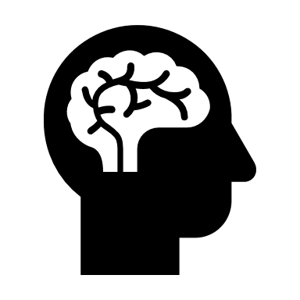
Expected Results: Visual vs. Auditory Reaction Time
Processing time = ~180 ms
Processing time = 200-250 ms
Notes:
Studies have shown that the average reaction time for an auditory stimulus is around 180 milliseconds, and the average reaction time for a visual stimulus is around 200-250 milliseconds.
This is due to those differences in proximity to the central nervous system as well as the complexity of the two sensory modality pathways. Other considerations include the number of connections in the brain required to process the stimuli, proximity to the brain and the complexity of the processing.
As mentioned earlier, the experiments we performed were truly measuring response time since we don’t have any EMG equipment to show us when muscle activation starts. But, since we were doing the same movement for both experiments, which was clicking the screen, movement time would stay relatively constant for both experiments. Therefore, the differences in the overall response time are due to the differences in reaction time. You’re going to see this in the next experiment as well.

Slide 14
Discussion Questions
What phase(s) of response time is indicated by the onset of muscle activation?
Why does auditory reaction time tend to be faster than visual reaction time?
Notes:
Q1: What phase (or what phases) of response time is indicated by the onset of muscle activation?
A: Onset of muscle activity indicates the end of reaction time and the beginning of movement time.
Q2: Why does auditory reaction time tend to be faster than visual reaction time?
A: This is due to the proximity of auditory receptors to the central nervous system. The neural pathway for auditory signals is shorter than the pathway for visual signals and less complex, and since they have less distance to travel, they can be processed faster.

Slide 15
HICK’S LAW
Notes:
We talked about how different stimulus modalities can affect reaction time, and now we’re going to investigate some other factors that can affect reaction time with Hick’s Law.

Slide 16
Response to Stimuli
Example: Swinging a baseball bat
Reaction Time (RT)
Movement Time (MT)
Stimulus
Muscle Activation
Movement completion
Response Time
Notes:
Hick's Law is in reference to the influences on reaction time. i.e. processes of the nervous system before movement is initiated.

Slide 17
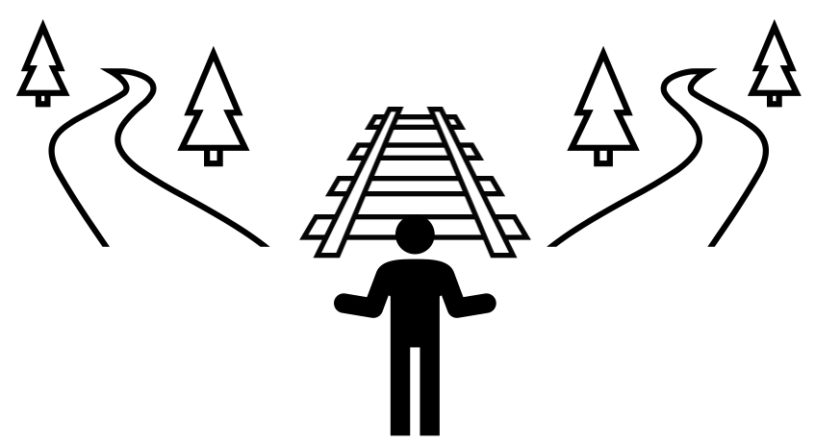
What Influences Reaction Time?
Task Complexity:
Tasks requiring more cognitive effort can affect reaction time and performance
Predictability:
The more predictable the stimuli, the faster the reaction time
MAKING DECISIONS
Notes:
One factor that can impact reaction time is task complexity. Tasks that require more cognitive effort can affect how fast we react and how well we perform. For example, a task that involves choosing between five possible responses will take more cognitive effort than a task that only has one possible response. More complex tasks are going to increase our reaction time, whereas less complex tasks will decrease reaction time.
Another factor that can influence reaction time is the predictability of a stimulus. Knowing when a stimulus will appear will affect how fast you are able to react. For example, a predictable stimulus could be starting gun in a race that has a 3, 2, 1 countdown, because you would know when that stimulus is going off. A predictable stimulus will reduce reaction time, while an unpredictable stimulus will increase reaction time.
We will focus on task complexity for the next few slides.

Slide 18
Hick’s Law
Hick’s Law: Reaction time will increase as the number of choices increase
Can be observed when examining differences between simple and choice reaction time
Increased Choices
Increased Complexity
Increased Processing Time
Increased Reaction Time
Notes:
Hick’s Law is the principle that relates task complexity to reaction time. Hick’s Law states that reaction time will increase as the number of choices increases. Essentially, increased choices mean increased task complexity, which means increased processing time, and therefore, increased reaction time.
We can see Hick’s Law in action when we look at the differences between simple and choice reaction time.

Slide 19
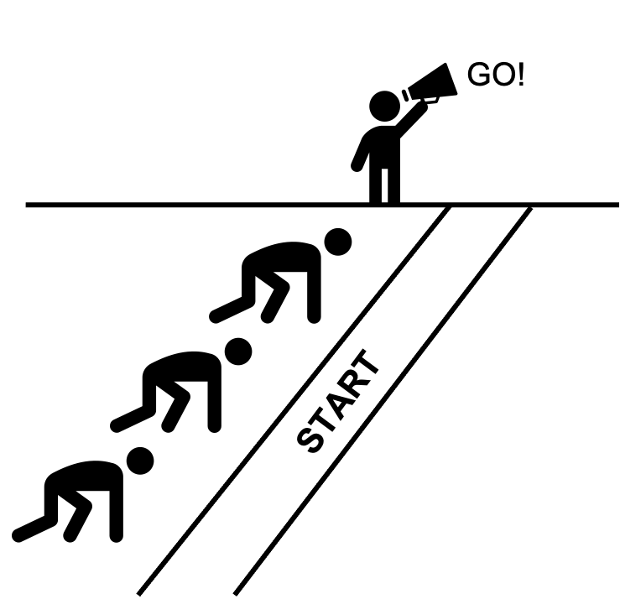
Simple Reaction Time (SRT)
The time it takes to respond to a single stimulus
Only one stimulus and one corresponding response
Example: Experiment 1A and 1B
SRT: STARTING A RACE
Notes:
Simple reaction time is the time it takes to respond to one stimulus with one corresponding response.
For example, at the start of a race when you hear the starting gun (stimulus), the only response is to start running.
Also, experiments 1A and 1B that we just performed would both be examples of simple reaction time. For each experiment, there was only one stimulus, which was the screen turning green for the first experiment, and the ‘ring’ sound for the second experiment. There was also only one corresponding response for each stimulus, which was clicking the screen.

Slide 20
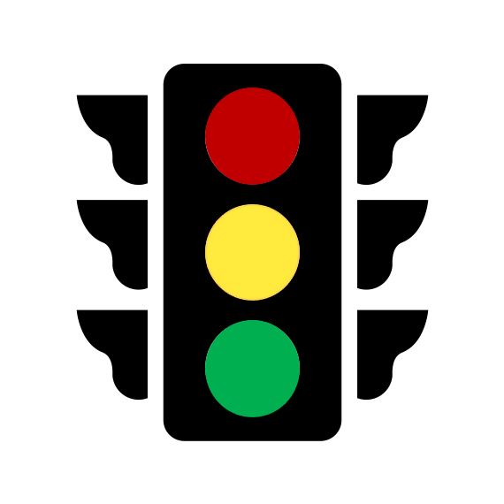
Choice Reaction Time (CRT)
The time it takes to respond to multiple stimuli with different corresponding responses
Assuming each stimulus should elicit a different response
Example: driving decision based on traffic light (e.g., stop, go, slow down)
CRT: TRAFFIC LIGHT
Notes:
Choice reaction time is the time it takes to respond to multiple stimuli that each elicit a different response.
For example, responding to a traffic light would involve choice reaction time. There are three different possible stimuli: red light, yellow light, and green light, and they each require a different response: stop, slow down, and go. Since the driver needs to decide the appropriate response for each stimulus, this would be a more complex task that requires more cognitive effort.
Like the stimulus modality experiments, tests like simple versus choice reaction time give us more insight into different aspects of information processing.

Slide 21
Experiment 2: SRT and CRT
Open Simple and Choice Reaction Time Test
Follow the instructions on the screen (you will perform the simple task first followed by the complex task)
Record your values for “response speed in simple task” and “response speed in choice task” on your recording sheet
https://www.psytoolkit.org/lessons/experiment_simple_choice_rts.html
Notes:
This is Experiment 2: Simple and Choice Reaction Time. (play video).
Instructions:
Open Simple and Choice Reaction Time Test
Follow the instructions on the screen (you will perform the simple task first followed by the complex task)
Record your values for “response speed in simple task” and “response speed in choice task”
Notes:
The black screen that shows response time will also show error %, this does not need to be recorded
Reference: Simple Choice Experiment (n.d.). Retrieved October 22, 2020, from https://www.psytoolkit.org/lessons/experiment_simple_choice_rts.html

Slide 22
Expected Results: Simple vs. Choice Task
Graph 2: Average Response Time for Simple and Choice Task
Notes:
This is our team’s results for the simple and choice tasks. As you can see on this graph, we have response time in milliseconds on our Y-axis, and our different task modalities on our X-axis. You’ll also notice that our team’s average response time for the choice task was longer than the simple task. The average response time was around 300 ms for simple task, and around 425 ms for choice task. These results were expected because we know that increased choices lead to increased decision making and processing time, and therefore an increased response time.
Were your response times around the same as these averages, were they faster, or slower?

Slide 23
Expected Results: SRT vs. CRT
Simple
Choice
This Whack-A-Mole visual helps to show Hick's Law in action. If there is only one hole for the mole to pop out of in a Whack-A-Mole game, the reaction time would be considerably quicker than when there are 6 possible holes for the mole to pop out of!
Notes:
The results for this experiment are consistent with Hick’s Law, which states that simple reaction time is faster than choice reaction time.
To further illustrate the effect of Hick’s Law, imagine playing a whack-a-mole game and there is only one hole that the mole is popping out of. You should be able to quickly whack this mole. This would be an example of simple reaction time, since there is only one place where the mole is appearing.
However, if there were six holes in this game, there are now several possibilities for where the mole might appear. You now need to process more options in order to accurately whack the mole, thereby increasing your reaction time. This would be an example of choice reaction time.

Slide 24
Discussion Questions
Why does an increased number of choices cause an increase in reaction time?
How many stimuli will be present in a simple reaction time task?
Notes:
Q1: Why does an increased number of choices cause an increase in reaction time? A: As we mentioned on our Hick’s Law slide, increased choices means increased complexity, which will result in more processing time and higher cognitive demand. We know that the CNS acts as the interpreter of the body, and the CNS takes more time to process this information simply because there is more information to process.
Q2: How many stimuli will be present in a simple reaction time task?
A: Simple reaction time tasks will have only one stimulus with one corresponding response. If there is more than one stimulus with one possible response, this would fall into choice reaction time.

Slide 25
FITTS’ LAW
Notes:
Now we’re going to get into Fitts’ Law.

Slide 26
Movement Time
Example: Swinging a bat
Reaction Time (RT)
Movement Time (MT)
Stimulus
Muscle Activation
Movement completion
Response Time
Notes:
So far, we’ve been focusing on factors that can impact reaction time. Now, we’re going to be focusing on factors that can impact movement time, which is the second component of response time.

Slide 27
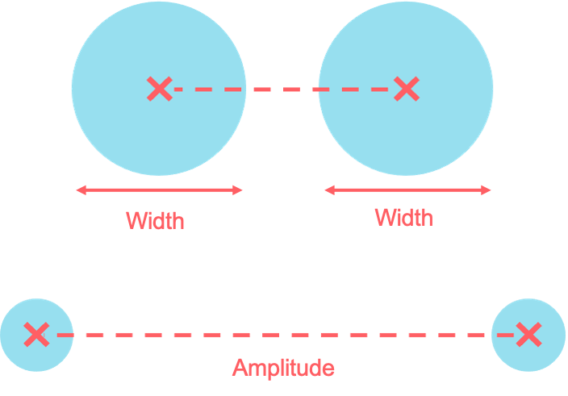
Fitts’ Law
Factors affecting movement time:
Width: How wide the targets are
Amplitude: How far apart the targets are (measured from center of target)
Smaller targets = longer movement time
Farther apart targets = longer movement time
X
X
X
X
FITTS’ LAW
Notes:
Fitts’ Law states that in general, the smaller the targets are, the longer our movement time will be, and the farther apart the targets are, the longer our movement time will be.
Movement time can be influenced by target width because wider targets tend to be easier to hit, and smaller targets tend to be more difficult to hit. Movement time can also be affected by amplitude because targets that are closer together require smaller movements, and targets that are far apart require larger movements.

Slide 28
Experiment 3: Fitts' Tapping Task
Open Fitts’ Tapping Task
Change # of trials to 5 and press start
Click back and forth between the two targets (moving to click blue target)
Values will appear at the end of the experiment: A – amplitude, W – width, MT – movement time
Record the mean movement time for each trial on your recording sheet
http://ergo.human.cornell.edu/FittsLaw/FittsLaw.html
Notes:
Now, we are going to try out Fitts’ Tapping Task to see how your movement time is affected when targets become wider/narrower, and closer/further apart. (play video).
Instructions:
Open Fitts’ Tapping Task
Change # of trials to 5 and press start
Click back and forth between the two targets (moving to click blue target)
Values will appear at the end of the experiment: A – amplitude, W – width, MT – movement time
Record the mean movement time for each trial on your data collection sheet
Reference: Reaction Time Test (n.d.). Retrieved October 22, 2020, from http://ergo.human.cornell.edu/FittsLaw/FittsLaw.html

Slide 29
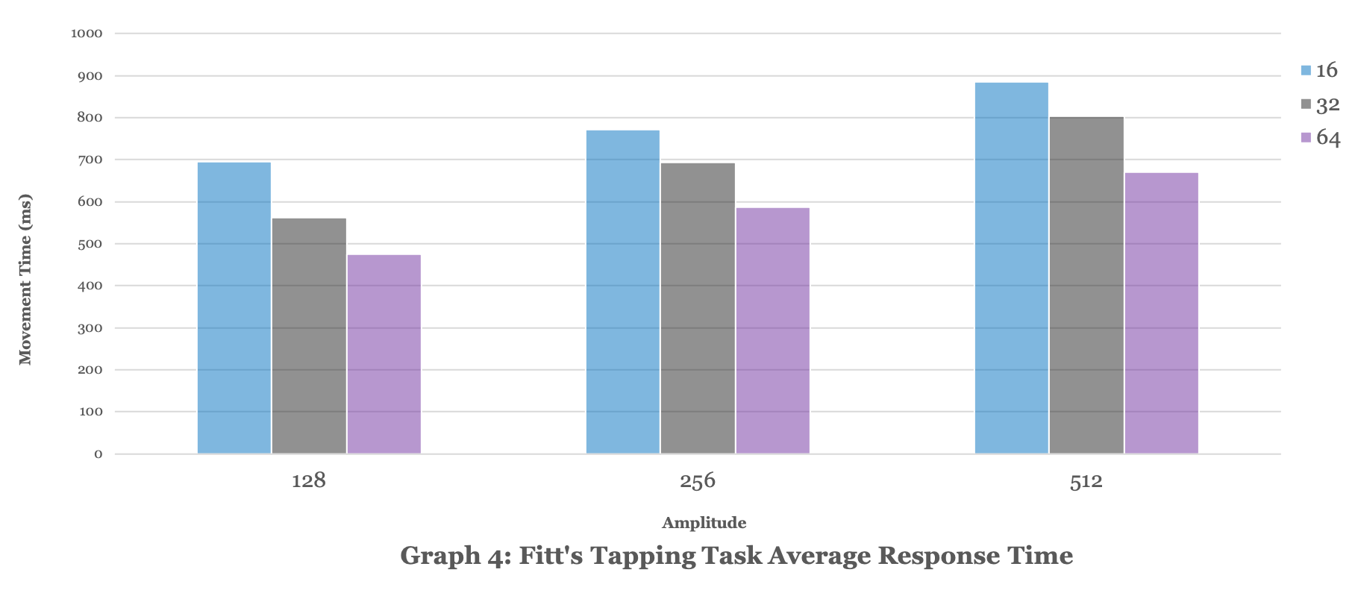
Expected Results: Fitts’ Tapping Task
Narrow
Narrow
Medium
Narrow
Medium
Wide
Medium
Wide
Movement Time (ms)
Wide
5 10 15
Distance between bars (cm)
Graph 3: Average Movement Time for Fitts’ Tapping Task
Notes:
There are two parameters to look at for the results of this experiment: movement amplitude and target width. We have movement time in milliseconds on our Y-axis, and amplitude on our X-axis. You’ll also notice that for each amplitude, we have three different bars for each target width (narrow, medium, and wide).
Within each distance between bars(5, 10 and 15), you’ll see that movement time decreases as the targets get wider. (Click once to reveal arrows). The narrow targets always have the longest movement time, followed by the medium targets, and then the wide targets. This is consistent with Fitts’ Law which states that as targets increase in width, movement time decreases.
You’ll also notice that movement time increases as the amplitude increases. (Click once to reveal brackets and arrow). This is also consistent with Fitts’ Law which states that as amplitude increases, movement time increases.

Slide 30
Expected Results: Fitts’ Tapping Task Movement Time
↑ Amplitude
↑ Movement Time
X
X
↑ Width
↓ Movement Time
X
X
FITTS’ LAW
Notes:
To summarize, it is expected that for Fitts’ Tapping Task, the targets that were wider and closer together had the shortest movement time, and the targets that were narrower and farther apart had the longest movement time. This is referred to as a speed-accuracy tradeoff, because in order to be more accurate with tapping targets that are narrow and far apart, we need to sacrifice quick movement time.

Slide 31
Discussion Questions
Under which conditions would you expect to see the shortest movement time: targets are wide and far apart, targets are narrow and close together, or targets are wide and close together?
What will happen to your accuracy in Fitts’ Tapping Task if you decrease the speed in which you complete the task?
Notes:
Q1: Under which conditions would you expect to see the shortest movement time: targets are wide and far apart, targets are narrow and close together, or targets are wide and close together?
A: We would expect to see the shortest movement time when targets are wide and close together. Fitts’ Law states that movement time decreases as targets get wider and closer together. In that first condition, we would have to sacrifice some movement time to reach targets that are far apart since they require larger movements. In the second condition we would sacrifice movement time when we’re trying to hit those narrow targets, since they’re more difficult and the movements need more finetuning.
Q2: What would happen to your accuracy in Fitts’ Tapping Task if you decrease the speed in which you complete the task?
A: If you decrease movement speed, your accuracy will increase. This is the speed accuracy trade-off we mentioned earlier, so if you want a faster movement time you’ll need to sacrifice accuracy, if you want more accuracy, you’ll have to sacrifice some movement time.

Slide 32
AUTOMATICITY
Notes:
Now we will discuss automaticity!

Slide 33
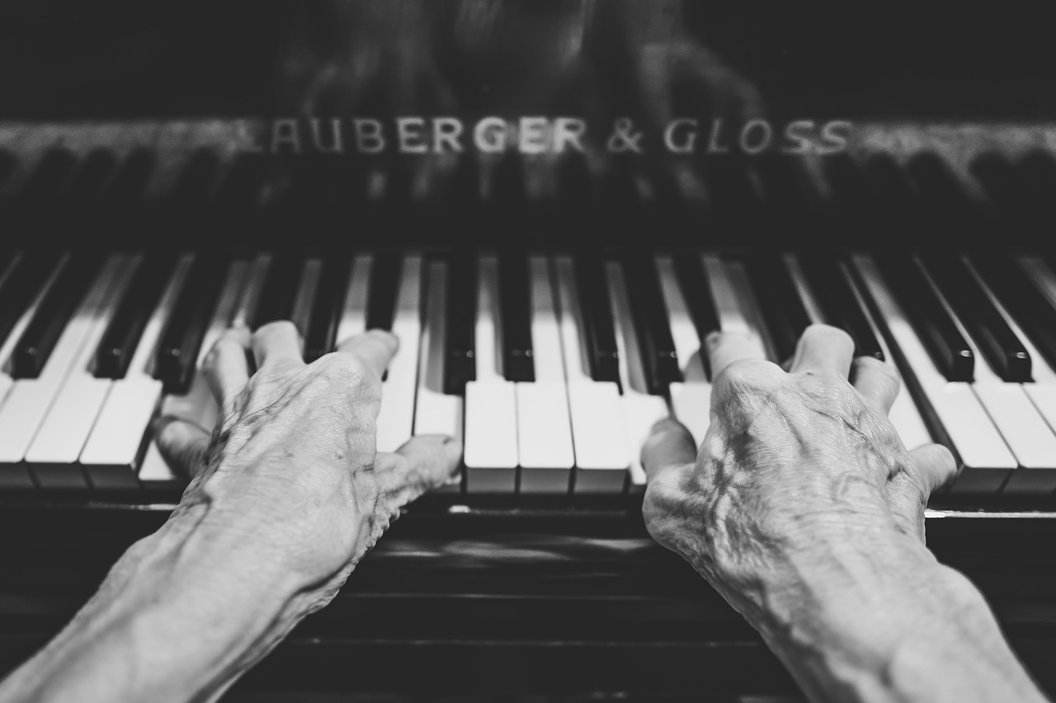
Automaticity
The ability to perform a task with little to no conscious control
Measure of learning
How do we determine whether a task is automatic or not?
Automaticity: When People Do Things Automatically - The World of Work Project
Notes:
Automaticity is the ability to perform a task with little to no conscious control. Automaticity is a measure of learning. It shows that a skill has become automatic to the performer.
Thinking back to the traffic light example when we were discussing choice reaction time, it might take longer for a new driver to determine how to respond to a light changing. However, for someone that has been driving a long time, they may not require as much conscious effort to decide how to respond to the stimuli.
How do we determine whether a task is automatic or not?
Source for piano picture: Automaticity: When People Do Things Automatically - The World of Work Project

Slide 34
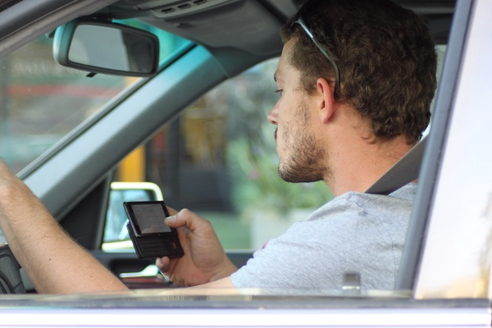
Measuring Automaticity: Dual-Task Paradigm
Dual-Task: A task is performed, and a second task is added (multi-tasking)
If task 1 is automatic, response time should not increase despite the addition of task 2
If task 1 response time increases with addition of task 2, task 1 may not be automatic
IMAGE CREDIT: Creative Commons
"April10 033" by Lord Jim is licensed under CC BY 2.0
Notes:
To determine if a task is automatic, one method is to use the Dual-Task Paradigm.
Dual-tasking is when a task is performed, and a second task is added. We often refer to this as multi-tasking. Multi-tasking occurs in everyday life, whether it be walking and chewing gum, listening to music while doing homework, or simply playing a sport.
The Dual-Task Paradigm states that if task 1 is automatic, response time should not worsen despite the addition of task 2. If task 1 performance worsens with the addition of task 2, this tells us that task 1 may not be automatic.
This paradigm helps us to understand how different tasks can interfere with each other and what type of tasks require more attention and cognitive effort.

Slide 35
EXPERIMENT 4 PART 1: SINGLE TASK (ST)
Task 1 (Walking):
Have the participant walk 10m and time them with a stopwatch
Record their time on the recording sheet
Calculate gait speed and record on the recording sheet
Gait speed = walking distance ÷ walking time
Notes:
This is Experiment 4 Part 1: Single Task.
Have the participant walk to the 10 m mark and time them with a stopwatch
Record their time on the recording sheet
Calculate gait speed by diving walking distance (m) by walking time (s), and record on the recording sheet
Take turns being the participant and experimenter. Round numbers to 2 decimal points.
Gait speed = walking distance (m) ÷ walking time (s)

Slide 36
EXPERIMENT 4 PART 2: DUAL-TASK (DT)
Task 2 (Walking and Cognitive Task):
Have the participant walk 10m while counting backwards from 100 by 7s (should be focusing on counting), and time them with a stopwatch
Record their time on the recording sheet
Calculate gait speed and record on the recording sheet
Calculate percentage of dual-task and record on the recording sheet
Dual-Task cost = [(DT gait speed – ST gait speed ) ÷ ST gait speed] x 100
100, 93, 86…
Gait speed = walking distance (m) ÷ walking time (s)
Notes:
This is Experiment 4 Part 2: Dual-Task.
Have the participant walk 10m while counting backwards from 100 by 7s (should be focusing on counting), and time them with a stopwatch
Record their time on the recording sheet
Calculate gait speed by dividing walking distance (m) by walking time (s)
Calculate percentage of dual-task cost using the dual-task cost equation
Take turns being the participant and experimenter. Round numbers to 2 decimal points.
Gait speed = walking distance (m) ÷ walking time (s)
Dual-Task cost = [(gait speed for DT – gait speed for ST) ÷ gait speed for ST] x 100

Slide 37
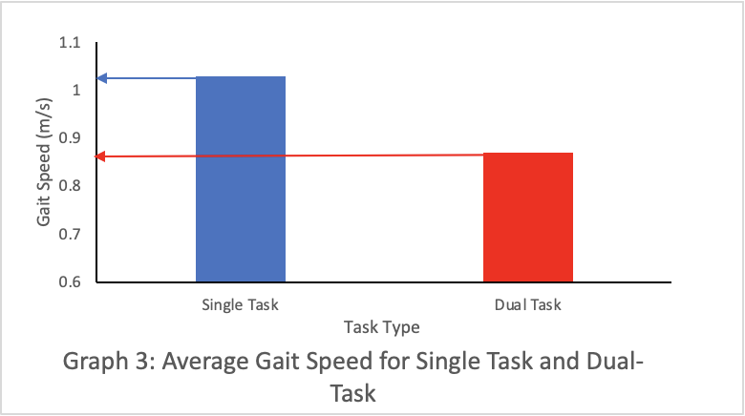
Expected Results: Single and Dual-Task Results
Notes:
We had our team perform the Dual-Task activity, and these are the average results. As you can see, we have gait speed in m/s on our Y-axis, and the task types on our X-axis. You’ll notice that gait speed was faster for the single task than the dual-task. The average gait speed was around 1.02 m/s for single task, and around 1.88 m/s for dual-task.
These results are expected, because walking is not considered an automatic task. The Dual-Task Paradigm states that if a task is not automatic, the addition of a second task will worsen the performance of the first task, which is consistent with these results. When the cognitive task was added to the walking task, walking performance declined.

Slide 38
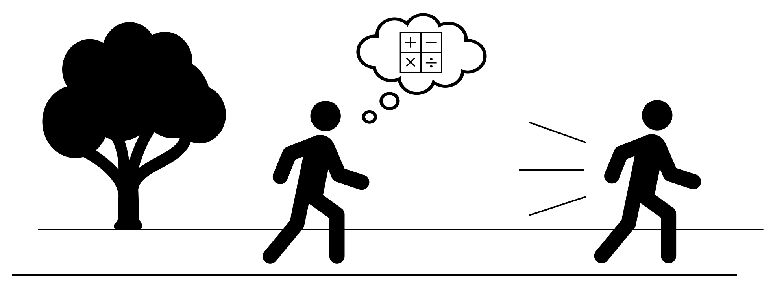
Expected Results: Dual-Task Paradigm
Notes:
During the dual-task activity, you likely noticed that walking and simultaneously counting backwards had a negative impact on your performance. Since these activities interfere with each other, neither task can be considered automatic.
There are a lot of tasks that are not as automatic as we think. For example, walking is something we do everyday, and many would think it requires little to no conscious control. However, studies show that when asked to perform different cognitive tasks while walking, like counting backwards, participants slow down. They also perform better on some of the cognitive tasks when they walk more slowly. This tells us that even tasks that seem simple and effortless can require some level of cognitive effort when dual-tasking.

Slide 39
Discussion Questions
What do errors tell us about automaticity in the context of the Dual-Task Paradigm?
What does the Dual-Task Paradigm tell us about scenarios like texting and driving, where neither driving nor texting can be considered automatic?
Notes:
What do errors tell us about automaticity?
If a learner is making a lot of errors when multitasking, we can assume that at least one of the tasks being performed is not automatic. Increased errors can be indicative of a worsened performance, and the Dual-Task Paradigm states that if the performance of a task worsens with the addition of a second task, the first task is not automatic.
What does the Dual-Task Paradigm tell us about scenarios like texting and driving, where neither driving nor texting can be considered automatic?
The Dual-Task Paradigm gives us insight about how much our task performances can be impacted when we introduce a second task. Since driving is not automatic, the addition of a second task will substantially affect your ability to drive. It is important that we understand how dual-tasking can worsen our performance in non-automatic tasks so that we avoid dangerous situations like texting and driving.

Slide 40
Using Reaction Time in Balance Control
Play video from 9:55 to 12:20
CBC Docs. (2020, March 6). Living better and aging well: David Suzuki takes us on a journey to learn how [Video]. YouTube. https://youtu.be/X3meWWwaLss.
Notes:
Earlier in this presentation, we mentioned how reaction time can be used to assess speed of processing.
In everyday life on several occasions, we have to process stimuli from our environment and make the appropriate movement. A prime example is regaining balance when we slip, trip, or are knocked off our feet.
At the University of Waterloo, we are interested in understanding the control of balance and how this control reflects health and disease. One of our researchers, Dr. Bill McIlroy is interested in reaction time when an individual loses their balance. Measuring reaction time in the muscles controlling the ankle allow us to assess how quick individuals can respond and regain their balance. A longer reaction time can be seen in older adults.
Reaction time is test on a moving platform. While on the moving platform, participants are hooked up to track brain and lower leg muscle activity using specialized equipment.
Here is a video showing Canadian icon, David Suzuki, visiting our Kinesiology labs and testing his balance on a moving platform. (play video).

Slide 42
Questions About the Program/Faculty?
Email: ahsinfo@uwaterloo.ca
This email address is for high school students who have questions about courses, co-op, careers, student experience, further education, and program applications within the Faculty Health
To find out how to connect with a student ambassador and ask them questions about student life in the Faculty of Health, check out: https://uwaterloo.ca/future-students/ask/ahs

Slide 43
END OF LAB WORKSHOP
Notes:
In this workshop, we’ve talked about reaction time, movement time and response time, and how they can be influenced. It’s also important to understand why we should learn about these things. The data collected in these research studies at UW can give us more insight regarding how reaction time may vary among different populations. These findings can potentially be used to help prevent dangerous falls, especially in populations that are more prone to falls. We hope this workshop provided you with some more neuroscience knowledge and that you’ll think back to these concepts when you experience them in your everyday life.

